Slide 1

English for Telephoning
Class: 18C1-NNA1
Time: 14.10 – 15.40 on
Lecturer: Ms. Nguyen Thi Thanh Tu
Faculty of Foreign Languages
Ly Tu Trong College of Ho Chi Minh City
Unit 4: When would suit you?

Slide 2
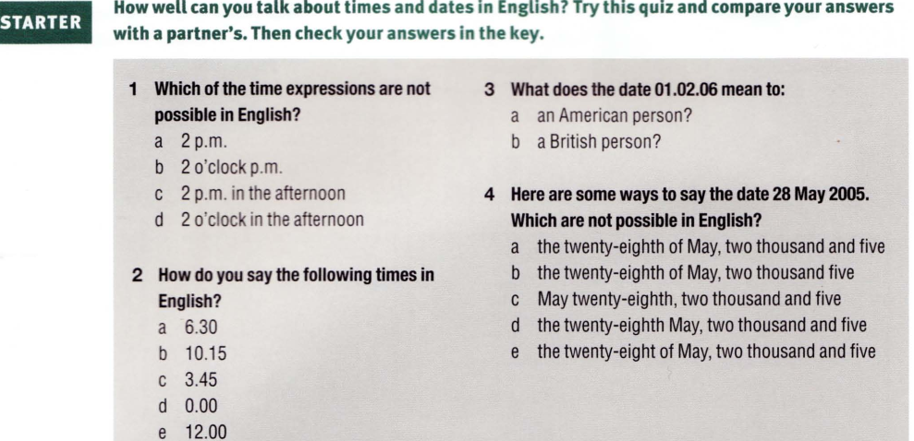
a. January 2, 2006
a
b. 1 February 2006
d
a
c
a. Half past six or six thirty
b. Quarter past ten or ten fifteen
c. Quarter to four or three forty-five
d. midnight
e. midday/ noon

Slide 3
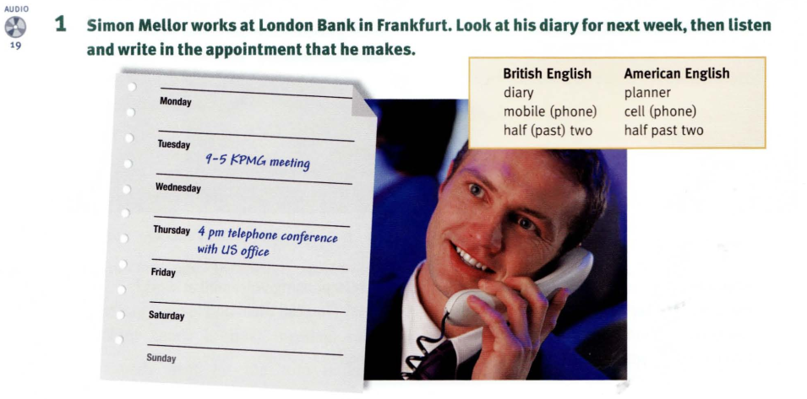


Slide 4
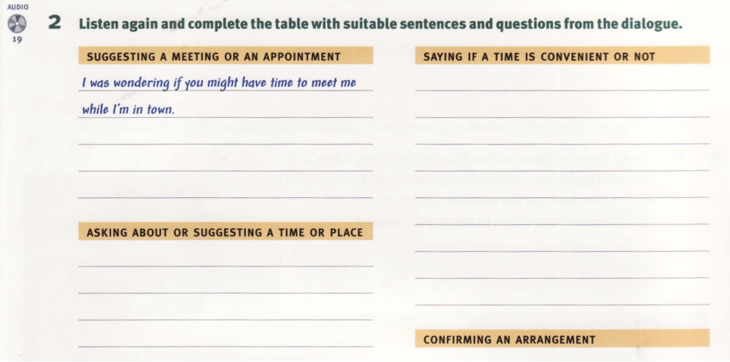


Slide 5
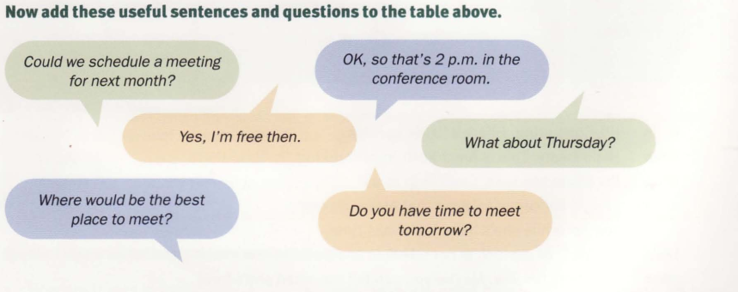

Slide 6
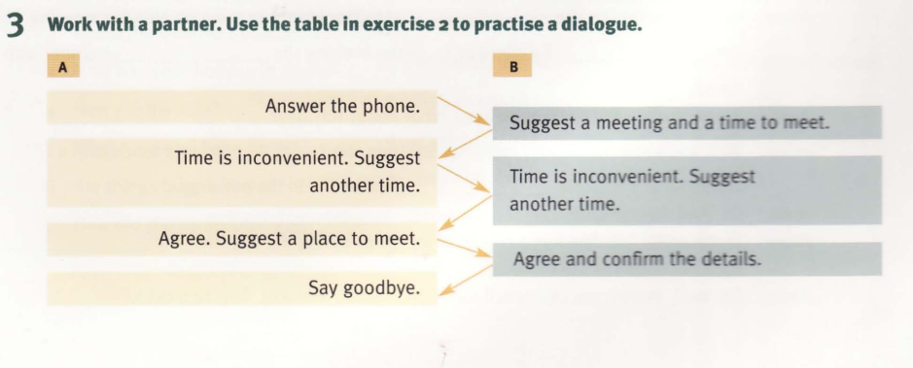
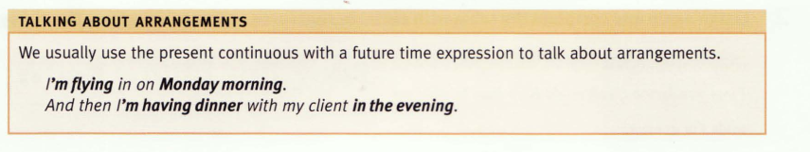

Slide 7
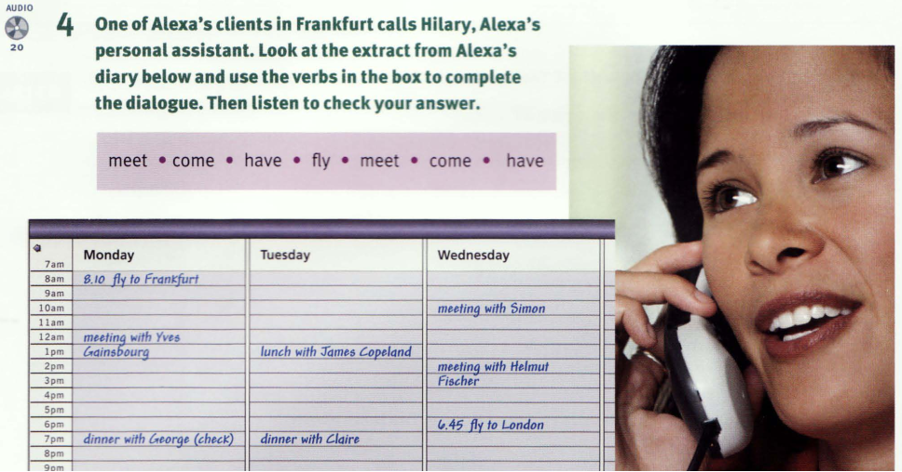

Slide 8
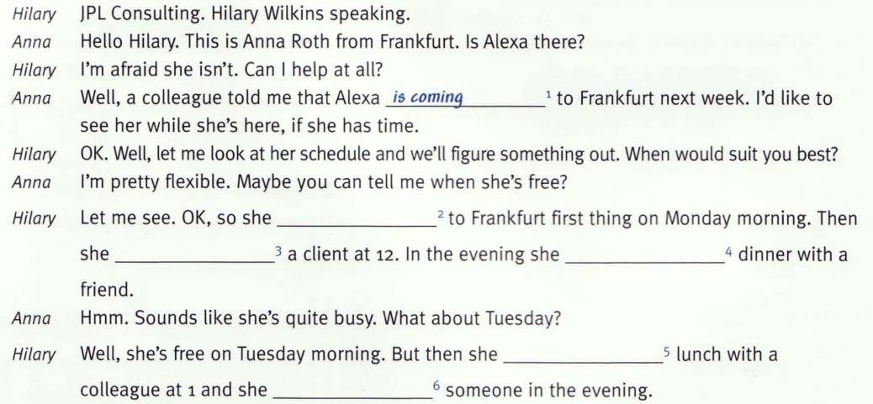
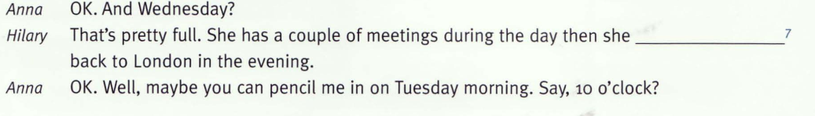

Slide 9
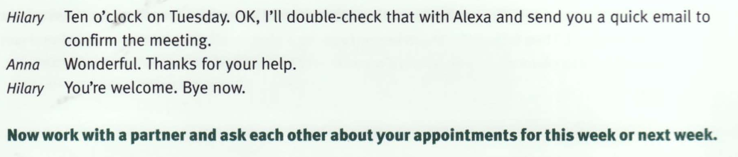
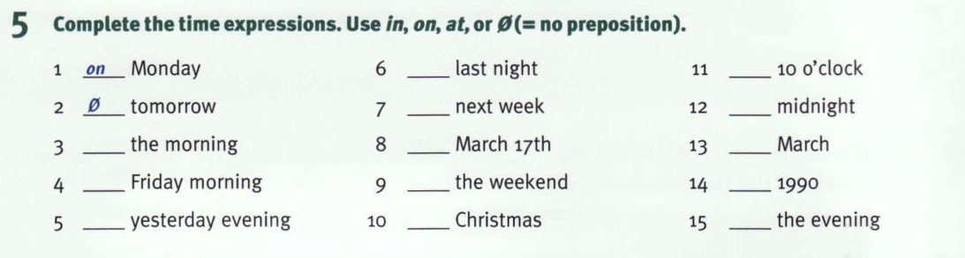

Slide 10
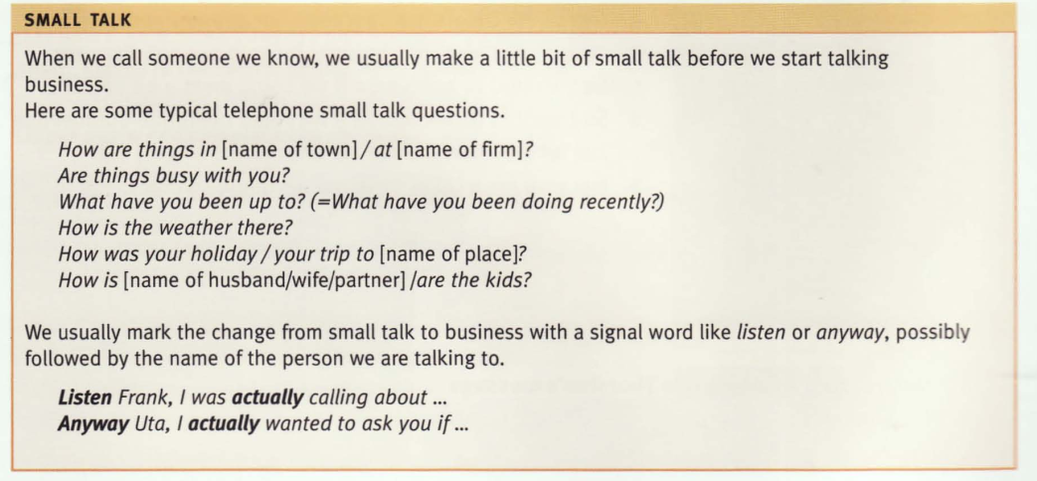

Slide 11
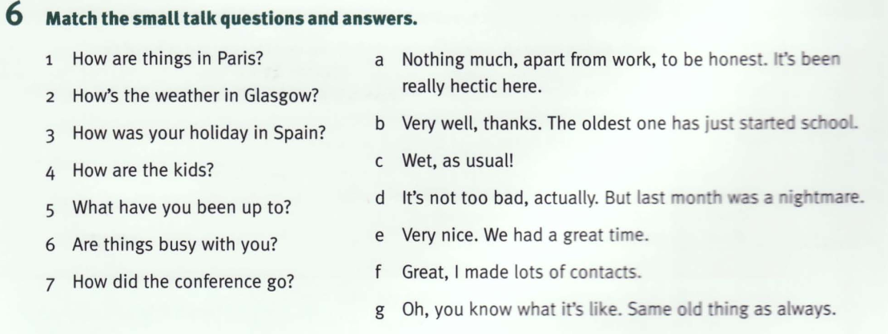

Slide 12
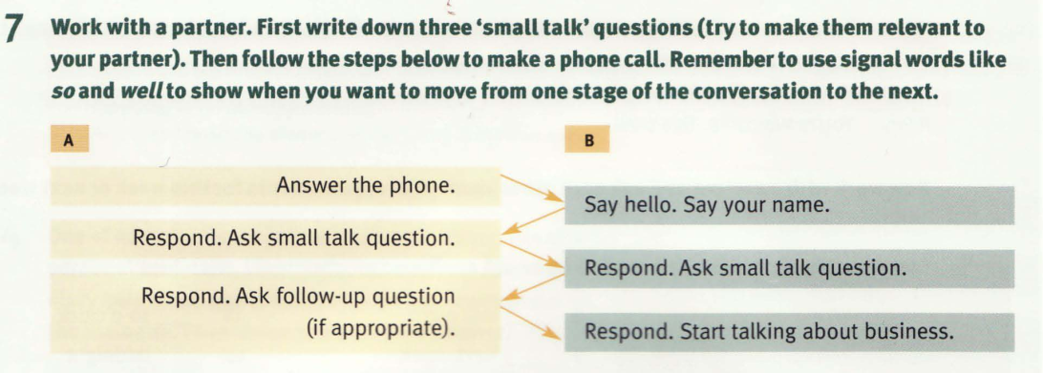

Slide 13
Homework:
After these two periods you have to learn all vocabulary.
Prepare for the rest parts of unit 4

